Slide 1
BANK CREDIT CARD
To predict whether a bank should give person a credit card or not.

Slide 2
PROBLEM DEFINITION
CLASSIFICATION PROBLEM ON THE DATASET THAT BANK SHOULD GIVE CREDIT CARD TO A PARTICULAR CUSTOMER BASED ON ITS DATA

Slide 3
DATA DICTIONARY
https://www.kaggle.com/sriharipramod/bank-loan-classification

Slide 4
Shape of dataset= (5000,14) ie.there are 5000 rows and 14 columns
Columns of dataset = ['ID', 'Age', 'Experience', 'Income', 'ZIP Code', 'Family', 'CCAvg', 'Education', 'Mortgage', 'Personal Loan', 'Securities Account', 'CD Account', 'Online', 'CreditCard']

Slide 5
●ID =Customer Identification Number
● AGE=Customer’s Age
● Experience= Tells about customer’s working experience as from how many years he has been working.
● Income=Tells about customer’s income.
● ZIP CODE= It represent the zonal code for a bank. Bank in different zones have different ZIP Code.

Slide 6
● Family=Tells about number of members in customer’s family.
●CC Avg= It tells the cash credit average a person can take form bank.
●Education= - A numerical data which tells the education of a person in years.
●Mortgage= A legal document signed during the loan. It tell us the number of time a person took loan from bank

Slide 7
●Personal Loan= Number of time a person took loan from bank for personal use.
●Securities Account= It represent the number of securities account a person have in a bank.
●CD Account= gives information about customer’s saving account
●Online= tells whether customer do online transaction or not.
●Credit Card=tells whether customer has credit card or not.

Slide 8
EDA(Exploratory Data Analysis)

Slide 9
Column Type
CATEGORICAL COLUMNS
NUMERICAL COLUMNS
Personal Loan
Online
Credit Card
CD Account
Securities Account
Education
Family
ID
Age
Income
ZIP CODE
Experience
CCAvg
Mortgage

Slide 10
Value count of column Education
1 =2096
2 = 1403
3=1501
Mode : 1
Dependency of CreditCard on Education:
 | Education=1 | Education=2 | Education=3
CreditCard=0 | 1463 | 1003 | 1064
CreditCard=1 | 633 | 400 | 437

Slide 11
Value count of Mortage w.r.t. CreditCard
 | Mortgage=0 | Mortgage=variable
CreditCard=0 | 2439 | __
CreditCard=1 | 1023 | __
Most of the people in dataset have Mortgage=0 and few of them have some varied numbers.

Slide 12
Value Count of Personal Loan
0 = 2439
1 = 1023
Mode=0
● Dependency of Credit Card on Personal Loan
 | Personal Loan=0 | Personal Loan=1
Credit Card=0 | 3193 | 337
Credit Card=1 | 1327 | 143
From these value we get that most of the person having credit card don't have personal loans. Person without any personal loan has more probability of having a credit card

Slide 13
Value Count of Securities Account
0 = 4478
1 = 522
Mode=0
● Dependency of Credit Card w.r.t.Securities Account .
 | Securities Account=0 | Securities Account=1
Credit Card=0 | 3150 | 379
Credit Card=1 | 1327 | 143
There is more probability that a person not having a security account will not have a credit card

Slide 14
Value Count of CD Account
0 = 4698
1 = 302
Mode=0
● Dependency of Credit Card w.r.t. CD Account .
 | CD Account=0 | CD Account=1
Credit Card=0 | 3468 | 62
Credit Card=1 | 1230 | 240
Form these value we get that there is high probability that if person is not having a CD account he will not have a credit card

Slide 15
Value Count of Online
0 = 2016
1 = 2984
Mode=1
● Dependency of Credit Card w.r.t. Online
 | Online=0 | Online=1
Credit Card=0 | 1428 | 2102
Credit Card=1 | 588 | 882
Different value counts provide us different probabilities that whether a person is having a credit card

Slide 16
● For Numerical data we will find - mean,mode,median
◊ DENSITY PLOT
◊ BOX PLOT

Slide 17
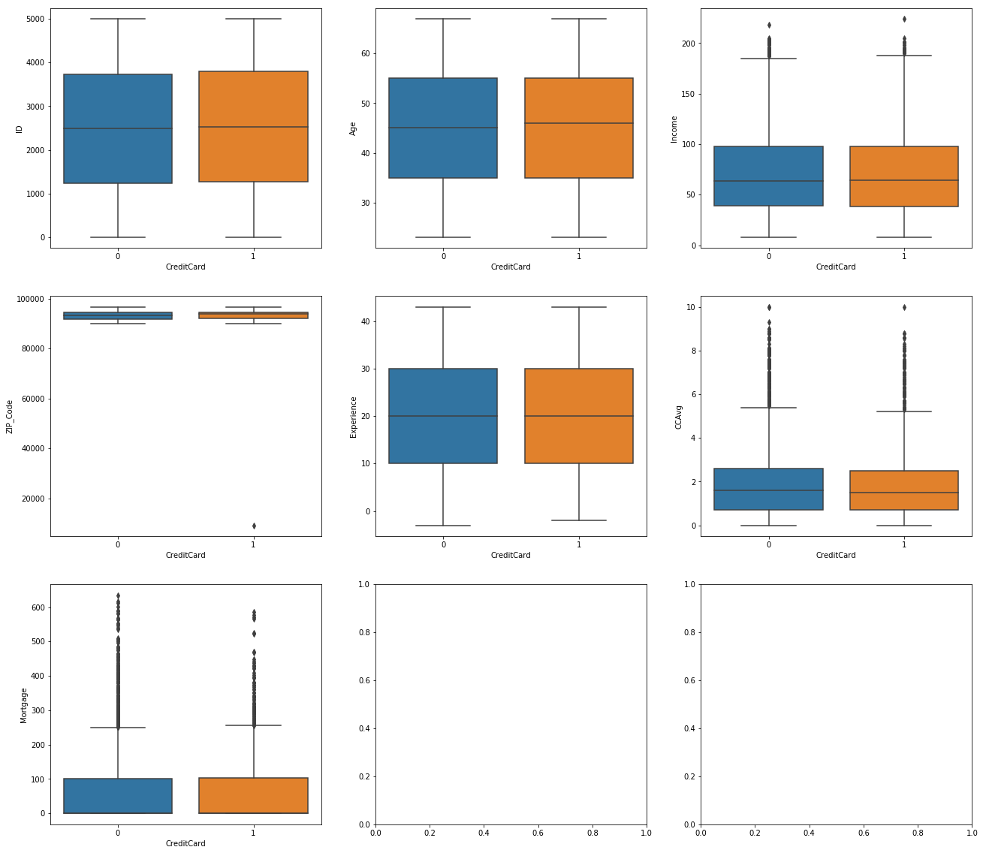

Slide 18
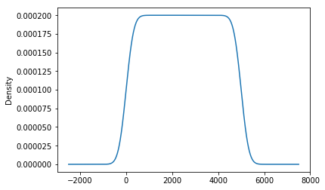
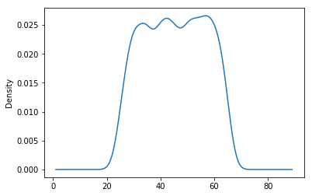
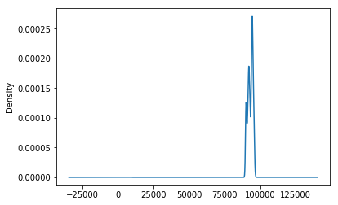
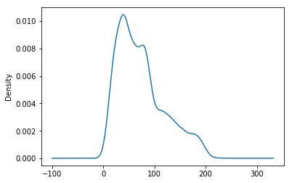
ID
Age
Income
ZIP Code

Slide 19
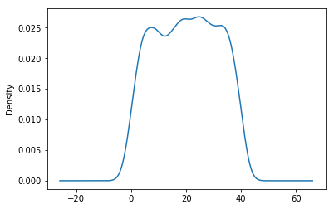
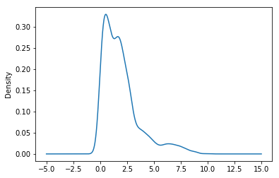
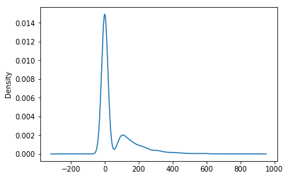
Experience
CCAvg
Mortgage

Slide 20
Observations of ID
mean = 2500
median = 2500
mode = Uni
(No Outliers)
● Observations of Age
mean = 45
median=45
mode= multi (30,42,55)
(No outliers)

Slide 21
● Observations of Income
mean = 60
median=90
mode= multi(30,90,120,180)
( outliers after 180)
● Observations of ZIP_Code
mean = 980000
median=960000
mode= multi
(No outliers)

Slide 22
● Observations of Experience
mean = 20
median=20
mode= multi(3,18,21,38) (No outliers)
● Observations of CCAvg
mean = 1.8
median=5
mode= multi (1,2.5,6.2)
(No outliers)

Slide 23
● Observations of Mortgage
mean = 45
median=45
mode= bi(0,100)
(No outliers)

Slide 24
DECISION TREE CLASSIFIER

Slide 25
DECISION TREE CLASSIFIER
FEATURE COLUMNS(X)= Age, Experience, Online, Personal_Loan, CD_Account, Securities_Account
TARGET VARIABLE(Y) = CreditCard
X_train = Data given to machine. We will pass the feature columns to the machine to train it
Y_train = outcome of the data which was given to the machine earlier would pass. Will give Target Variable to the machine

Slide 26
X_test = would pass the new data to the machine ie. feature columns and machine would predict the result
Y_test= The result which came after the test ie. Target Variable
Y_predict= The correct outcome of feature columns given to machine for Y_test
test _size = Percentage of Data we would want to pass to machine as a test
random_state= seeds given randomly
max_depth = upto which depth tree should go
min_leaf= minimum leaf nodes we want

Slide 27
Accuracy = would compare machine’s Y_test and Y_predict
( accuracy came after decision tree impementation is 73.2%)
● Entropy = It chooses the split which has lowest entropy compared to parent node and other splits. The lesser the entropy, the better it is.
● Accuracy = the accuracy came after entropy criterion is 77.2%

Slide 28
Pruning = Cutting the tree is called pruning
Overfitting = when model becomes baised and too accurate for only one dataset

Slide 29
Profit Scheme
Now as a bank I will always try to make some profit. So i will always try that a person who will be using Credit card often must get it in any case.
Person who will not be using credit card and got it will not be a big loss for a bank but if bank is not able to give a card to person who might have used it more then its a loss.

